Slide 1
Decision-Tree for Classification
M AC H I N E L E A R N I N G W I T H T R E E - B A S E D M O D E L S I N P Y T H O N
Elie Kawerk
Data Scientist

Slide 2
Classification-tree
Sequence of if-else questions about individual features.
Objective: infer class labels.
Able to capture non-linear relationships between features and labels. Don't require feature scaling (ex: Standardization, ..)
Classification tree methods (such as Decision Trees, Random Forests, and Gradient Boosted Trees) do not require feature scaling (like standardization or normalization) because they are inherently scale-invariant (Invariant means unchanging or remaining constant under specific transformations or conditions.)
Decision trees partition the feature space by comparing feature values to thresholds. These comparisons depend only on the relative order of the feature values, not their absolute magnitudes or units.
Many algorithms like k-Nearest Neighbors (k-NN), Support Vector Machines (SVMs), or Linear Regression rely on distance calculations or dot products, which are sensitive to the scale of the features. Decision trees, however, do not compute distances between data points. Instead, they evaluate individual feature thresholds, making them unaffected by the scale of the features.
Classification trees use measures like Gini Impurity or Entropy to evaluate the quality of a split. These measures are based on the class distribution in a node and are independent of the feature scales.
Decision trees do not assume linear relationships between features and the target variable. Features are treated independently, and splits are determined purely based on information gain (or similar criteria).
The classification tree method does not require feature scaling because:
It uses thresholds for splitting based on relative order; It evaluates splits using impurity measures that are unaffected by the scale.
It does not involve distance metrics or gradient-based optimization.
This property makes decision trees and tree-based ensemble methods highly practical for datasets with features on different scales or units.

Slide 3
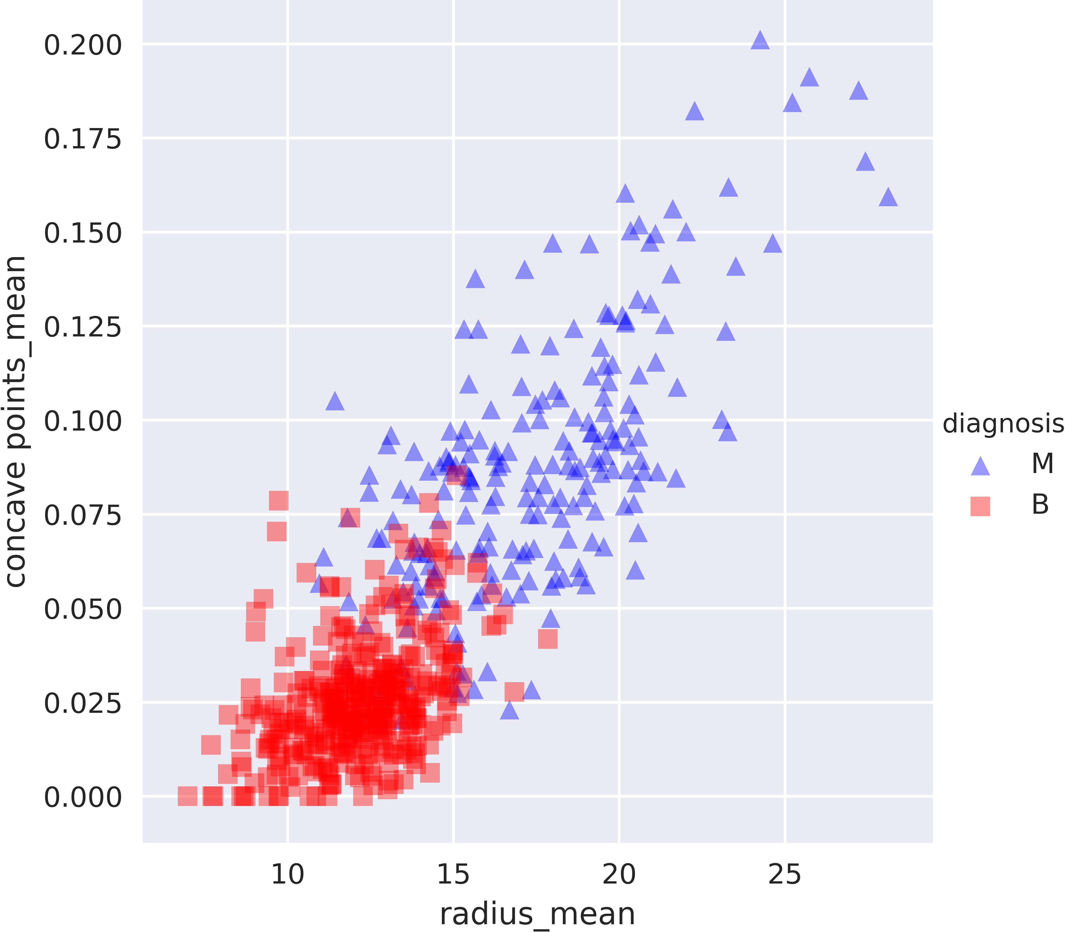
Breast Cancer Dataset in 2D

Slide 4
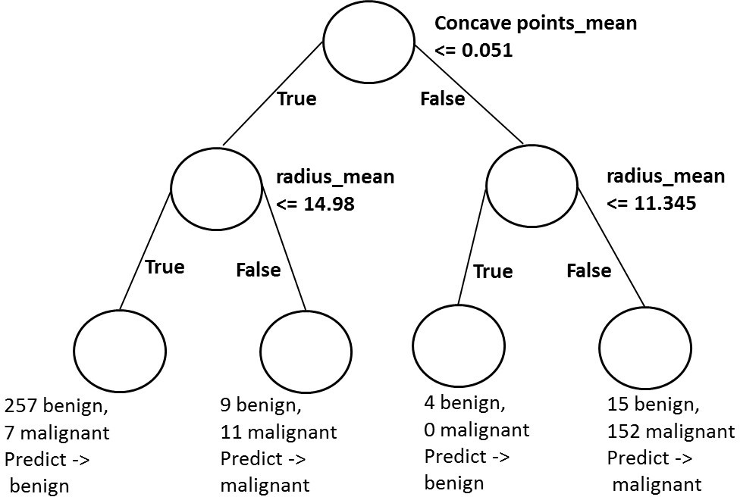
Decision-tree Diagram
Concave points in the context of breast cancer typically refer to concave-shaped indentations along the boundary of a tumor or lesion. These points are a geometric feature extracted from imaging data (e.g., mammograms or histopathological images) and are often used in computational analysis for distinguishing between benign and malignant tumors.
Radius mean refers to the mean radius of tumor nuclei computed from medical imaging (e.g., mammograms or histopathological images).

Slide 5
Classification-tree in scikit-learn
# Fit dt to the training set dt.fit(X_train,y_train)
# Predict the test set labels y_pred = dt.predict(X_test)
# Evaluate the test-set accuracy accuracy_score(y_test, y_pred)
0.90350877192982459

Slide 6
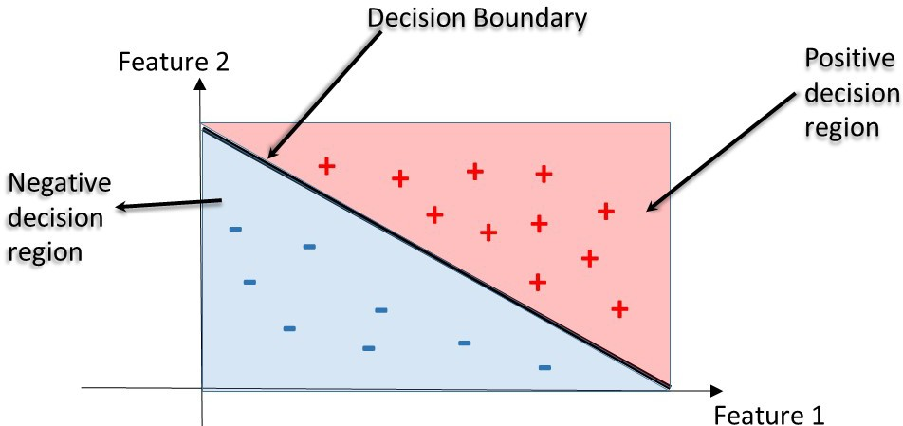
Decision Regions
Decision region: region in the feature space where all instances are assigned to one class label.
Decision Boundary: surface separating different decision regions.

Slide 7
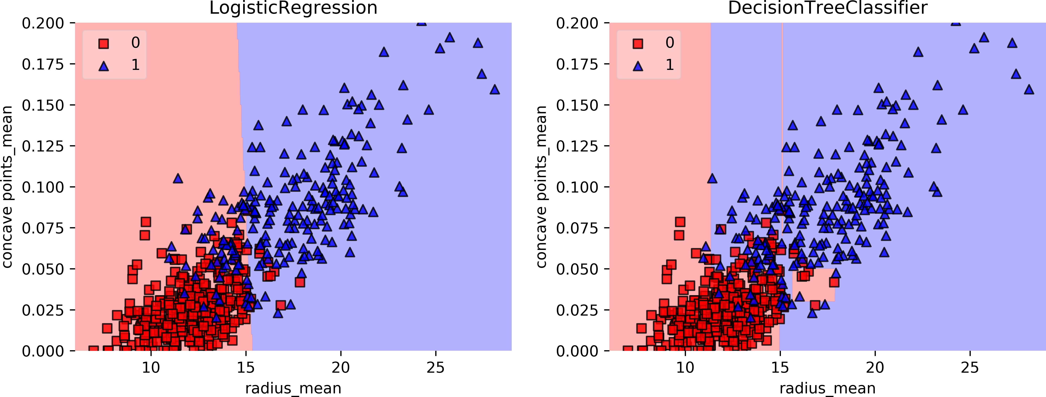
Decision Regions: CART vs. Linear Model
CART stands for Classification and Regression Trees, a machine learning algorithm used for both classification and regression tasks.

Slide 8
Classification-Tree Learning
M AC H I N E L E A R N I N G W I T H T R E E - B A S E D M O D E L S I N P Y T H O N
Elie Kawerk
Data Scientist

Slide 9
Building Blocks of a Decision-Tree
Decision-Tree: data structure consisting of a hierarchy of nodes.
Node: question or prediction.

Slide 10
Building Blocks of a Decision-Tree
Three kinds of nodes:
Root: no parent node, question giving rise to two children nodes.
Internal node: one parent node, question giving rise to two children nodes.
Leaf: one parent node, no children nodes --> prediction.

Slide 11
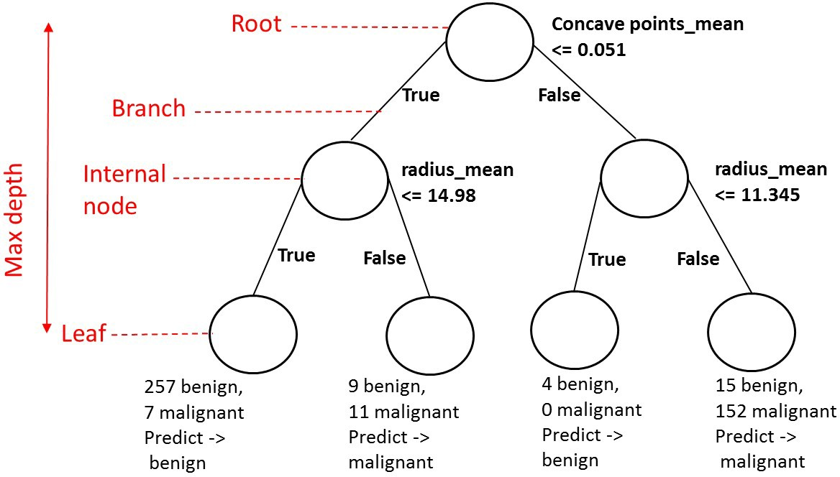
Prediction

Slide 12
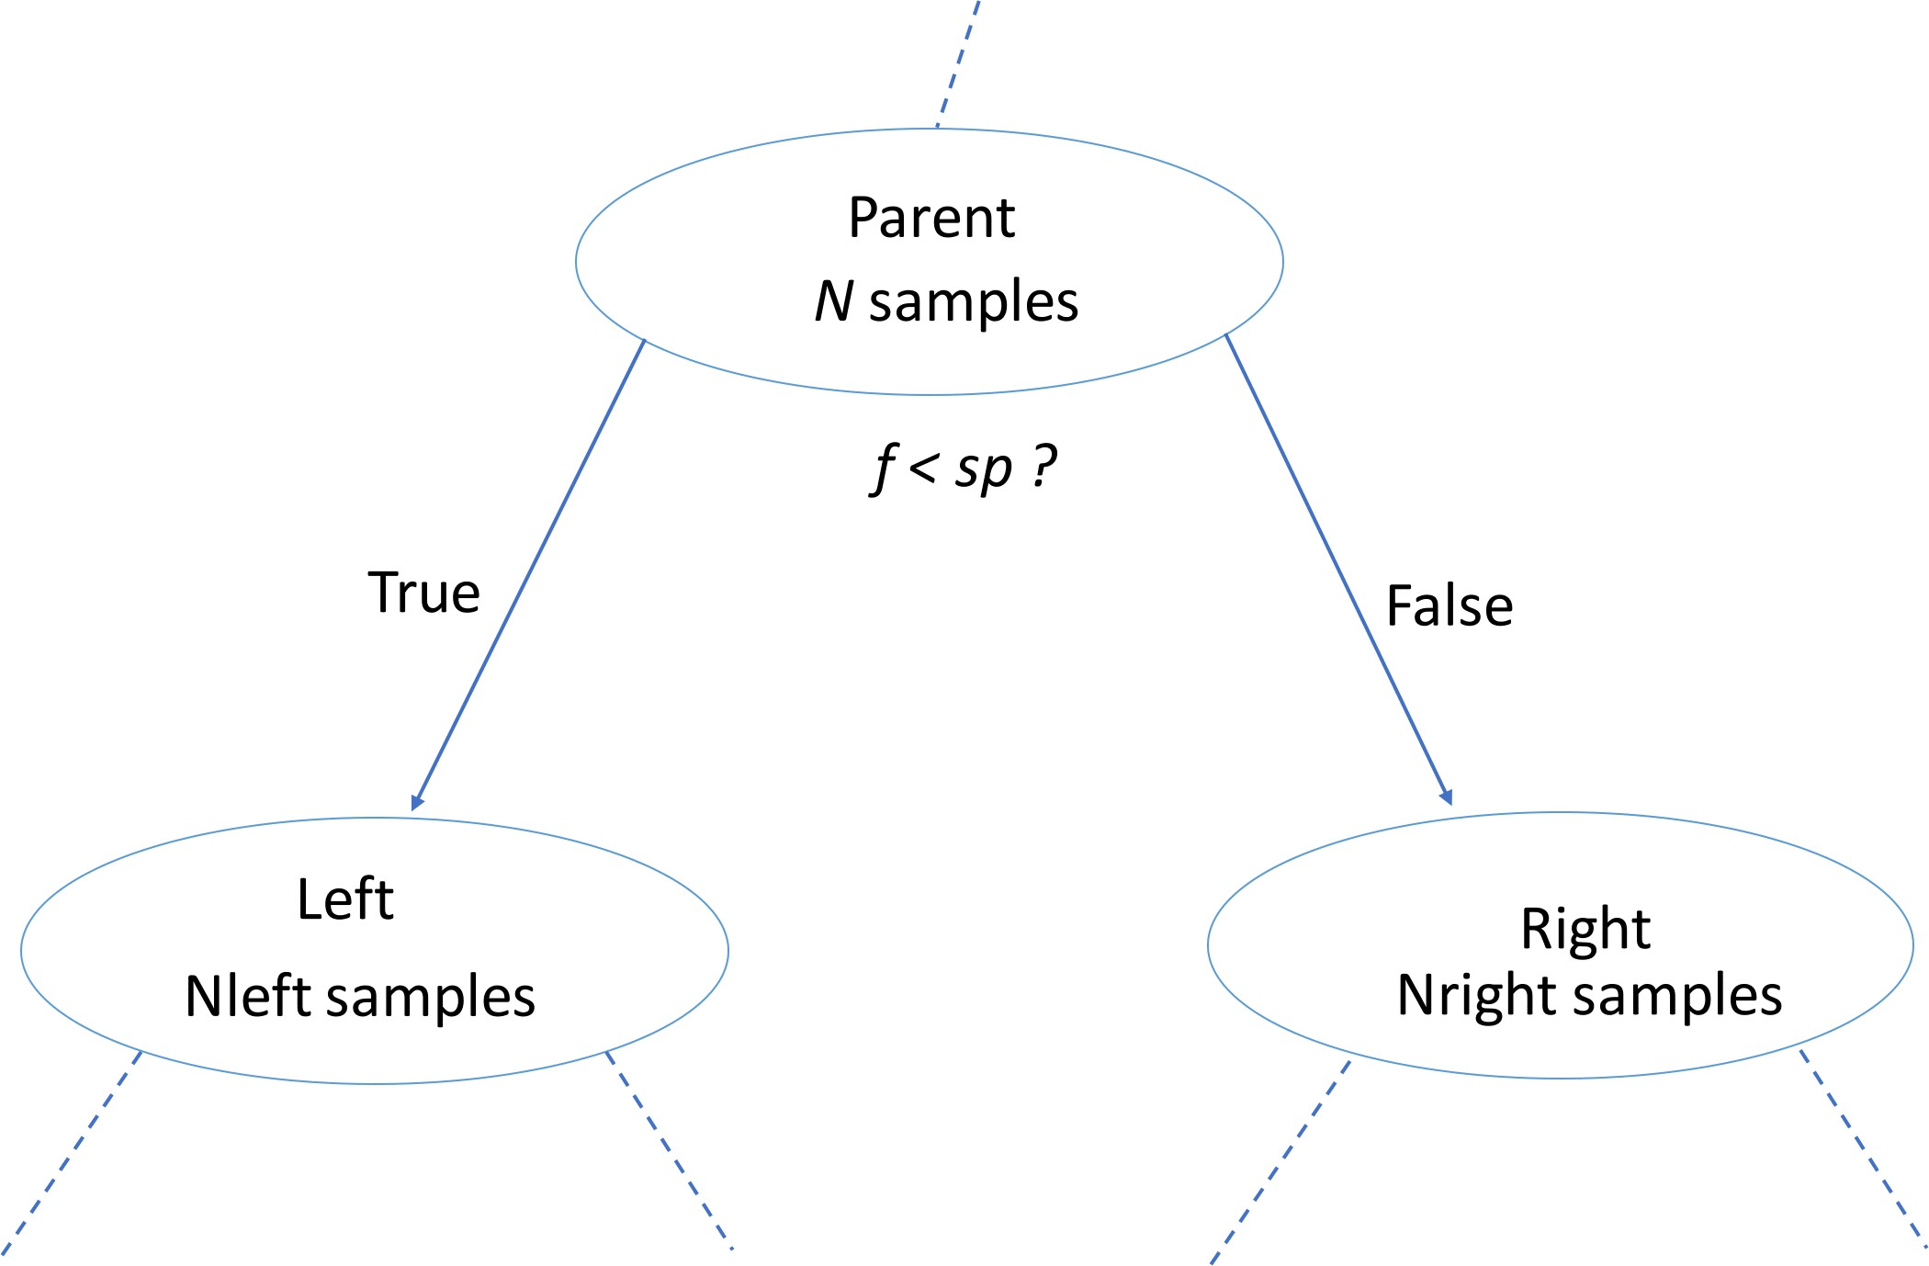
Information Gain (IG)
Information Gain is a key metric used in decision tree algorithms for selecting the best feature to split the data at each step. It measures the reduction in impurity achieved by a split, quantifying how well a particular split separates the data into homogeneous groups.
f: feature
sp: split point

Slide 13
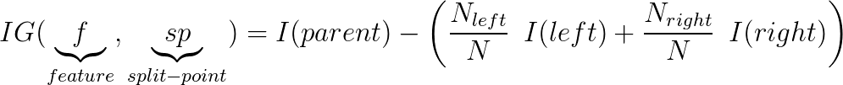
Information Gain (IG)
Criteria to measure the impurity of a node I(node):
gini index, entropy. ...
The Gini Index, also known as Gini Impurity, is a metric used in decision to evaluate the quality of a split. It measures the level of impurity or disorder in a dataset, with the goal of minimizing impurity in child nodes after a split.
Key Properties of the Gini Index
Range:
The Gini Index ranges from 0 to 1.
Gini = 0: Pure node (all samples belong to one class).
Gini = 1: Maximum impurity (all classes are equally represented).
Interpretation:
Lower Gini values indicate purer nodes.
Splits are chosen to minimize the Gini Index, resulting in more homogeneous child nodes.

Slide 14
Classification-Tree Learning
Nodes are grown recursively.
At each node, split the data based on:
feature f and split-point sp to maximize IG(node).
If IG(node)= 0, declare the node a leaf. ...

Slide 15
# Import DecisionTreeClassifier
sklearn.tree DecisionTreeClassifier
# Import train_test_split sklearn.model_selection
# Import accuracy_score
train_test_split
sklearn.metrics accuracy_score # Split dataset into 80% train, 20% test
X_train, X_test, y_train, y_test= train_test_split(X, y,
test_size=0.2, stratify=y, random_state=1)
# Instantiate dt, set 'criterion' to 'gini'
dt = DecisionTreeClassifier(criterion='gini', random_state=1)

Slide 16
Information Criterion in scikit-learn
# Fit dt to the training set dt.fit(X_train,y_train)
# Predict test-set labels y_pred= dt.predict(X_test)
# Evaluate test-set accuracy accuracy_score(y_test, y_pred)
0.92105263157894735

Slide 17
Decision-Tree for Regression
M AC H I N E L E A R N I N G W I T H T R E E - B A S E D M O D E L S I N P Y T H O N
Elie Kawerk
Data Scientist

Slide 18
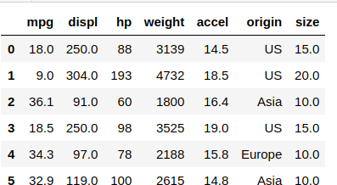
Auto-mpg Dataset

Slide 19
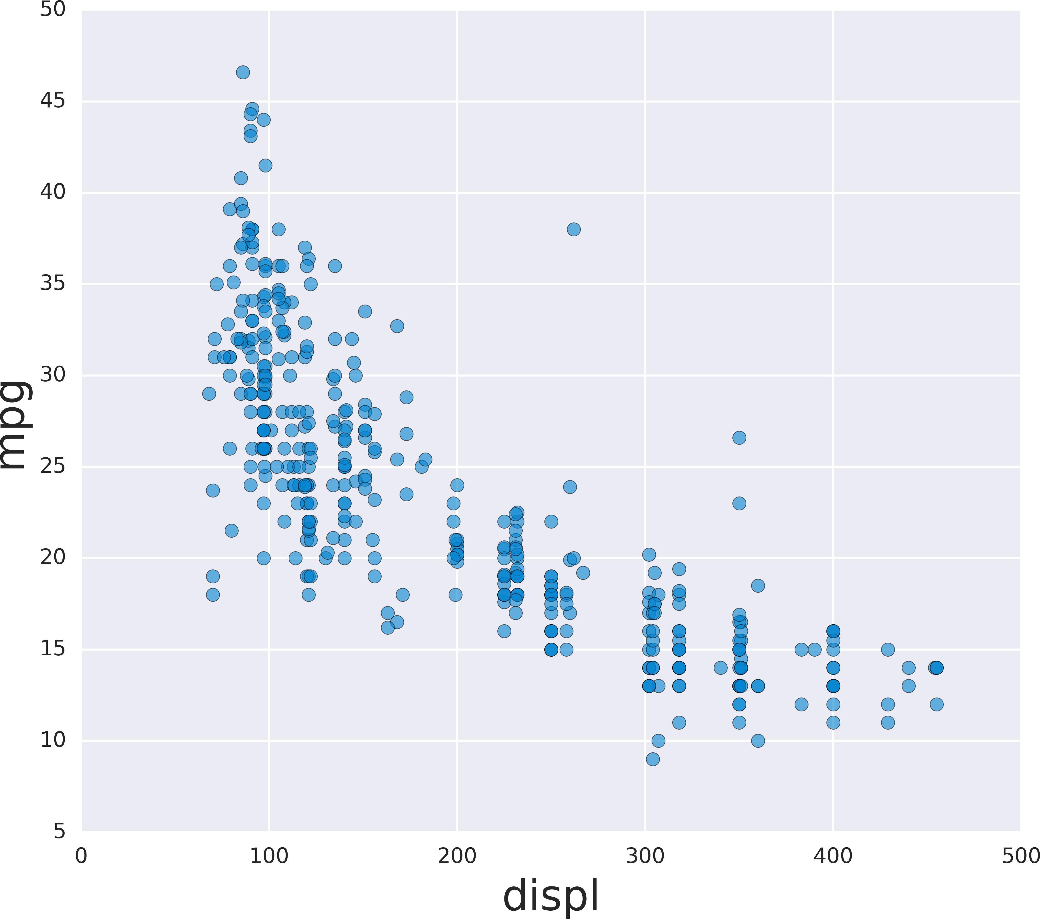
Auto-mpg with one feature

Slide 20
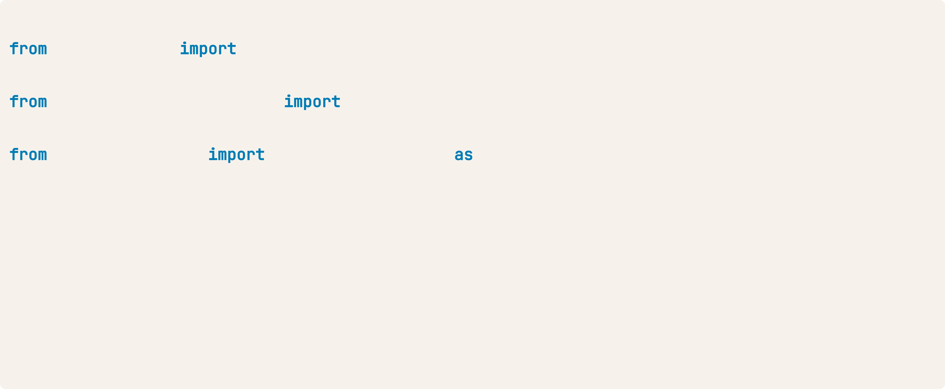
Regression-Tree in scikit-learn
# Import DecisionTreeRegressor
sklearn.tree DecisionTreeRegressor
# Import train_test_split sklearn.model_selection
# Import mean_squared_error as MSE
train_test_split
sklearn.metrics mean_squared_error MSE # Split data into 80% train and 20% test
X_train, X_test, y_train, y_test= train_test_split(X, y,
test_size=0.2, random_state=3)
# Instantiate a DecisionTreeRegressor 'dt' dt = DecisionTreeRegressor(max_depth=4,
min_samples_leaf=0.1, random_state=3)

Slide 21
Regression-Tree in scikit-learn
# Fit 'dt' to the training-set dt.fit(X_train, y_train)
# Predict test-set labels y_pred = dt.predict(X_test) # Compute test-set MSE mse_dt = MSE(y_test, y_pred) # Compute test-set RMSE rmse_dt = mse_dt**(1/2)
# Print rmse_dt print(rmse_dt)
5.1023068889
Root Mean Squared Error (RMSE) is a commonly used metric to evaluate the performance of regression models, including Regression Trees. It measures the average magnitude of prediction errors by taking the square root of the mean of squared differences between predicted and actual values.
RMSE quantifies how far off the predicted values are from the actual values.
Lower RMSE indicates better model performance.

Slide 22
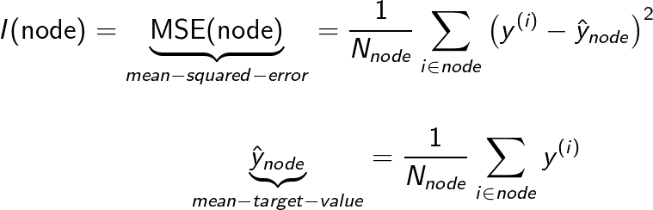
Information Criterion for Regression-Tree
As the tree grows, the RSS decreases because the model captures more details of the data (fit improves).
However, the complexity penalty increases due to the addition of more parameters (splits or nodes).

Slide 23
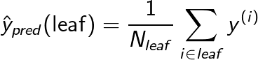
Prediction

Slide 24
Linear Regression vs. Regression-Tree

